Slide 1
CS 2009 Design and Analysis of Algorithms
Lecture 3, 4 and 5:
Asymptotic Analysis

Slide 2
Efficiency of Algorithm
Revision
INTRODUCING...
ASYMPTOTIC ANALYSIS
Some guiding principles:
we want some measure of runtime that’s independent of hardware, programming language, memory layout, etc.
We want to reason about high-level algorithmic approaches rather than lower-level details
we care about how the running time/number of operations scales with the size of the input (i.e. the runtime’s rate of growth),
Not concerned with small values of n, Concerned with VERY LARGE values of n.
Asymptotic –refers to study of function f as n approaches infinity

Slide 3
Asymptotic Analysis (High Level Idea)
Revision
We’ll express the asymptotic runtime of an algorithm using
BIG-O NOTATION
We would say Multiplication “runs in time O(n²)”
Informally, this means that the runtime “scales like” n²
What will be the complexity of a simple loop
for (i = 1, i < n, I = i+1)
print A[i];
c₁ + c₂ (n+1) + c_{3.}n + c₄.n

Slide 4
Asymptotic Analysis (High Level Idea)
Revision
BIG-O NOTATION
THE POINT OF ASYMPTOTIC NOTATION
suppress constant factors and lower-order terms
too system dependent
irrelevant for large inputs
Example f(n) = 2n² + 4n + 1
f(n) = O(n²): 2 is constant, n² is the dominant term, and the term 4n + 1 becomes insignificant as n grows larger.

Slide 5
Runtime Analysis
There are a few different ways to analyze the runtime of an algorithm:
We’ll mainly focus on worst case analysis since it tells us how fast the algorithm is on any kind of input
Worst-case analysis:
What is the runtime of the algorithm on the worst possible input?
Best-case analysis:
What is the runtime of the algorithm on the best possible input?
Average-case analysis:
What is the runtime of the algorithm on the average input?

Slide 6
Big-O Notation
Let f(n) & g(n) be functions defined on the positive integers.
What do we mean when we say “f(n) is O(g(n))”?
In Math
f(n) = O(g(n))
if and only if there exists positive constants c and n₀ such that for all n ≥ n₀
f(n) ≤ c · g(n)
f(n) grows no faster than g(n)
or
g(n) is upper bound on f(n)
In Picture
n₀
c·g(n)
f(n)
Runtime (ms)
g(n)
n (input size)
Notes:
Say T(n) = O(f(n)) is loose analogy of saying “T <= f”

Slide 7
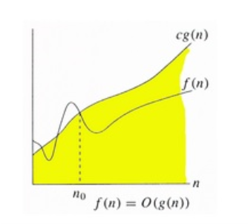
Big-O Notation
Let f(n) & g(n) be functions defined on the positive integers.
What do we mean when we say “f(n) is O(g(n))”?
In Math
f(n) = O(g(n))
if and only if there exists positive constants c and n₀ such that for all n ≥ n₀
f(n) ≤ c · g(n)
In Picture
Notes:
Say T(n) = O(f(n)) is loose analogy of saying “T <= f”

Slide 8
Big-O Notation
Let f(n) & g(n) be functions defined on the positive integers.
What do we mean when we say “f(n) is O(g(n))”?
In Math
f(n) = O(g(n))
if and only if there exists positive constants c and n₀ such that for all n ≥ n₀
f(n) ≤ c · g(n)
In Math
f(n) = O(g(n))
⇔ ∃ c , n₀ > 0 s.t. ∀ n ≥ n₀ ,
f(n) ≤ c · g(n)
Notes:
Say T(n) = O(f(n)) is loose analogy of saying “T <= f”

Slide 9
Proving Big-O Bounds
If you’re ever asked to formally prove that f(n) is O(g(n)), use the MATH definition:
f(n) = O(g(n))
⇔ ∃ c , n₀ > 0 s.t. ∀ n ≥ n₀ ,
f(n) ≤ c · g(n)
“if and only if”
“for all”
must be constants! i.e. c & n₀ cannot depend on n!
“there exists”
“such that”
To prove f(n) = O(g(n)), you need to announce your c & n₀ up front!
Play around with the expressions to find appropriate choices of c & n₀ (positive constants)
Then you can write the proof! Here how to structure the start of the proof:

Slide 10
Proving Big-O Bounds: Example # 2 (Method # 1)
Prove that f(n) = 3n² + 5n + 7 = O(n²).
f(n) = O(g(n))
⇔ ∃ c , n₀ > 0 s.t. ∀ n ≥ n₀ ,
f(n) ≤ c · g(n)
find a c & n₀ such that for all n ≥ n₀:
3n² + 5n + 7 ≤ c • n²
Divide both sides by n², we get:
3 n² / n² + 5n/ n² + 7/n² ≤ c • n² /n²
3 + 5/n + 7/n² ≤ c
If we choose n₀ equal to 1 then we have value of c
3 + 5 + 7 ≤ c
c ≤ 15
3n² + 5n + 7 ≤ 15n² for n ≥ 1
Proved that f(n) = 3n² + 5n + 7 = O(n²) [for c = 15, n₀ = 1]

Slide 11
Proving Big-O Bounds: Example # 2 (Method # 2)
Prove that f(n) = 3n² + 5n + 7 = O(n²).
f(n) = O(g(n))
⇔ ∃ c , n₀ > 0 s.t. ∀ n ≥ n₀ ,
f(n) ≤ c · g(n)
find a c & n₀ such that for all n ≥ n₀:
3n² + 5n + 7 ≤ c • n²
3n² ≤ 3n² for n ≥ 0
5n ≤ 5n² for n ≥ 0
≤ 7n² for n ≥ 1
3n² + 5n + 7 ≤ 3n² + 5n² + 7n² for n ≥ 1
3n² + 5n + 7 ≤ 15n² for n ≥ 1
Proved that f(n) = 3n² + 5n + 7 = O(n²) [for c = 15, n₀ = 1]

Slide 12
Proving Big-O Bounds: Example # 1 (Method # 2)
Prove that f(n) = 3n² + 5n = O(n²).
f(n) = O(g(n))
⇔ ∃ c , n₀ > 0 s.t. ∀ n ≥ n₀ ,
f(n) ≤ c · g(n)
find a c & n₀ such that for all n ≥ n₀:
3n² + 5n ≤ c • n²
3n² ≤ 3n² for n ≥ 0
5n ≤ 5n² for n ≥ 0
3n² + 5n ≤ 3n² + 5n² for n ≥ 0
3n² + 5n ≤ 8n² for n ≥ 0
So f(n) = 3n² + 5n = O(n²) [for c = 8, n₀ = 0]
The c & n₀ are selected as positive constants, so:
Proved that f(n) = 3n² + 5n = O(n²) [for c = 8, n₀ = 1]
Notes:
Desmos yes

Slide 13
Proving Big-O Bounds: Example # 3 (Method # 2)
Show that f(n) = 5n log₂ n + 8n + 200 = O(n log₂ n).
f(n) = O(g(n))
⇔ ∃ c , n₀ > 0 s.t. ∀ n ≥ n₀ ,
f(n) ≤ c · g(n)
find a c & n₀ such that for all n ≥ n₀:
5n log₂ n + 8n + 200 ≤ c • n log₂ n
5n log₂ n + 8n + 200 ≤ 5n log₂ n + 8n log₂ n + 200n log₂ n for n ≥ 2
5n log₂ n + 8n + 200 ≤ 213n log₂ n for n ≥ 2
Thus
f(n) = 5n log₂ n + 8n + 200 = O(n log₂ n) [for c = 213, n₀ = 2]
Notes:
Desmos: yes

Slide 14
PROVING BIG-O BOUNDS: EXAMPLE
f(n) = O(f(n))
⇔ ∃ c , n₀ > 0 s.t. ∀ n ≥ n₀ ,
f(n) ≤ c · g(n)
c = 61
n₀= 1
Prove that n² + 57n + 3 = O(n²).
c = 8
n₀= 1
Prove that 3n² + 5n = O(n²).
c = 2
n₀= 1
Prove that n² + n = O(n³).

Slide 15
Disproving Big-O Bounds
If you’re ever asked to formally disprove that T(n) is O(f(n)), use proof by contradiction!
This means you need to show that NO POSSIBLE CHOICE of c & n₀ exists such that the Big-O definition holds

Slide 16
Disproving Big-O Bounds
Skip in Class
f(n) = O(g(n))
⇔ ∃ c , n₀ > 0 s.t. ∀ n ≥ n₀ ,
f(n) ≤ c · g(n)
Prove that 3n² + 5n is not O(n).
For sake of contradiction, assume that 3n² + 5n is O(n). This means that there exists positive constants c & n₀ such that 3n² + 5n ≤ c・n for all n ≥ n₀. Then, we would have the following:
3n² + 5n ≤ c・n
3n + 5 ≤ c
n ≤ (c - 5)/3
However, since (c - 5)/3 is a constant, we’ve arrived at a contradiction since n cannot be bounded above by a constant for all n ≥ n₀. For instance, consider n = n₀ + c: we see that n ≥ n₀, but n > (c - 5)/3. Thus, our original assumption was incorrect, which means that 3n² + 5n is not O(n).

Slide 17
Big-Ω Notation
Let f(n) & g(n) be functions defined on the positive integers.
What do we mean when we say “f(n) is Ω(g(n))”?
In Math
f(n) = Ω(g(n))
⇔ ∃ c , n₀ > 0 s.t. ∀ n ≥ n₀ ,
f(n) ≥ c · g(n)
In Pictures
n₀
g(n)
f(n)
Runtime (ms)
c·g(n)
inequality switched directions!
n (input size)

Slide 18
Big-Ω Notation
Let f(n) & g(n) be functions defined on the positive integers.
What do we mean when we say “f(n) is Ω(g(n))”?
In Math
f(n) = Ω(g(n))
⇔ ∃ c , n₀ > 0 s.t. ∀ n ≥ n₀ ,
f(n) ≥ c · g(n)
inequality switched directions!

Slide 19
PROVING BIG-Ω NOTATION
Prove that n³ + 4n² = Ω (n²).
Proof: Here we have f(n) = n³ + 4n² and g(n) = n2
When n ≥ 1,
n² ≤ n³ ≤ n³ + 4n²
^{Therefore,}
1. n² ≤ n³ + 4n²
^{Thus we have shown}
n³ + 4n² = Ω (n²) c = 1, n₀ = 1

Slide 20
Big-Ө Notation
We say “f(n) is Ө(g(n))”
if and only if both
f(n) = O(g(n)) and g(n) = Ω(g(n))
f(n) = Ө(g(n))
⇔ ∃ c₁ , c₂ , n₀ > 0 s.t. ∀ n ≥ n₀ ,
c₁· g(n) ≤ f(n) ≤ c₂· g(n)

Slide 21
PROVING BIG-Ө NOTATION
Prove that n² + 4n² = Ө (n²).
f(n) = Ө(g(n))
⇔ ∃ c₁ , c₂ , n₀ > 0 s.t. ∀ n ≥ n₀ ,
c₁· g(n) ≤ f(n) ≤ c₂· g(n)
n² + 4n² = Ө (n²) c₁ = ?, c₂ = ? n₀ = ?
c₁ x n² ≤ n² + 4n² ≤ c₂ n²
c₁ x n² ≤ 5n² ≤ c₂ n²
1 x n² ≤ 5n² ≤ 5 n²
1 x n² ≤ n² + 4n² ≤ 5 n²
c₁ = 1, c₂ = 5 n₀ = 1
Notes:
c₀ = 1, c₁ = 1 n₀ = 1

Slide 22
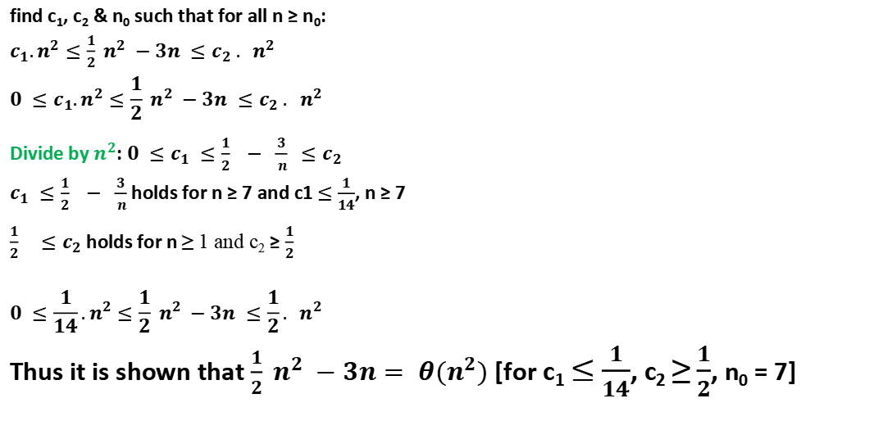
Proving Big- Ө Bounds: Example (Method # 1)
Show that $f\left(n\right)\frac{1}{2} n^{2} −3n= θ(n^{2})$
f(n) = Ө(g(n))
⇔ ∃ c₁ , c₂ , n₀ > 0 s.t. ∀ n ≥ n₀ ,
c₁· g(n) ≤ f(n) ≤ c₂· g(n)
find c₁, c₂ & n₀ such that for all n ≥ n₀:
$c_{1}.n^{2}≤\frac{1}{2} n^{2} −3n ≤c_{2} . n^{2}$
$$0 ≤c_{1}.n^{2}≤\frac{1}{2} n^{2} −3n ≤c_{2} . n^{2}$$
Divide by $n^{2}$: $0 ≤c_{1} ≤\frac{1}{2} − \frac{3}{ n} ≤c_{2}$
$c_{1} ≤\frac{1}{2} − \frac{3}{ n}$ holds for n ≥ 7 and c1 $≤$ $\frac{1}{14}$, n ≥ 7
$\frac{1}{2} { ≤c}_{2}$holds for n ≥ 1 and c₂ ≥ $\frac{1}{2}$
$$0 ≤\frac{1}{14}.n^{2}≤\frac{1}{2} n^{2} −3n ≤\frac{1}{2}. n^{2}$$
Thus it is shown that $\frac{1}{2} n^{2} −3n= θ(n^{2})$ [for c₁ $≤$ $\frac{1}{14}$, c₂ ≥ $\frac{1}{2}$, n₀ = 7]

Slide 23
Proving Big-O Bounds: Example # 3(ii) (Method # 2)
Show that f(n) = 5n log₂ n + 8n - 200 = O(n log₂ n).
f(n) = O(g(n))
⇔ ∃ c , n₀ > 0 s.t. ∀ n ≥ n₀ ,
f(n) ≤ c · g(n)
find a c & n₀ such that for all n ≥ n₀:
5n log₂ n + 8n - 200 ≤ c • n log₂ n
While finding c and n0, in
5n log₂ n + 8n - 200 ≤ 5n log₂ n + 8n log₂ n
5n log₂ n + 8n - 200 ≤ 13n log₂ n for n ≥ 2
Thus
f(n) = 5n log₂ n + 8n - 200 = O(n log₂ n) [for c = 13, n₀ = 2]
Notes:
Desmos: Although n0 = 2, is not shown, but for given c value, g(n) always upper bound, so suffice, even if n0 is a large value.
Check by method 1

Slide 24
Proving Big-O Bounds: Example # 3 (Method # 2)
Prove that f(n) = 3n² + 5n - 7 = O(n²).
f(n) = O(g(n))
⇔ ∃ c , n₀ > 0 s.t. ∀ n ≥ n₀ ,
f(n) ≤ c · g(n)
find a c & n₀ such that for all n ≥ n₀:
3n² + 5n - 7 ≤ c • n²
3n² ≤ 3n² for n ≥ 0
5n ≤ 5n² for n ≥ 0
-7 ≤ -7n² for n ≥ 1
3n² + 5n - 7 ≤ 3n² + 5n² for n ≥ 0
3n² + 5n - 7 ≤ 8n² for n ≥ 1
Proved that f(n) = 3n² + 5n - 7 = O(n²) [for c = 8, n₀ = 1]
Notes:
Desmos not shown it to be right, because of negative term in equation

Slide 25
Asymptotic Notations (continued)
O(1) - Constant Time
Algorithm requires same fixed number of steps regardless of the size of the task.
For example: Push/Pop in Stack or Insert or Remove for a Queue.
Constant Time Algorithms are best algorithms unless that time is very long.
25 = O(1), i.e. [any constant] = O(1)
O(n) – Linear Time
Algorithm requires number of steps proportional to the size of the task.
For example: Traversal of linked-list or array, finding max./min. element in a list etc.
O (lg n)
Algorithm having running time growing more slowly than the size of the input.
Double the input, and the running time only gets a little longer, not doubled.
For example: Binary Search.

Slide 26
Asymptotic Notations (continued)
O(n²) - Quadratic Time
The number of operations is proportional to the size of task squared.
Example 1: Selection sort of n elements.
Example 2: Comparing two-dimensional array of size n by n
Big-O notation
Big-O only gives sensible comparison of algorithms in different complexity classes when n is large.
Big-O notation cannot compare algorithms in the same complexity class.
For example: O(n²) is a set, or family, of fucntion with the same of smaller order of growth like n² + n, 100n + 5, 4n² – n lg n + 12, n²/5 – 100n, n log n, 50n, and so forth. Moreover, note! n³ ∉ O (n²)

Slide 27
Arithmetic of of Big-O, Ω and Ө Notations
Transitivity
f(n) ∈ O (g(n)) and g(n) ∈ O (h(n)) ⇒ f(n) ∈ O (h(n))
f(n) ∈ Ω (g(n)) and g(n) ∈ Ω (h(n)) ⇒ f(n) ∈ Ω (h(n))
f(n) ∈ Ө (g(n)) and g(n) ∈ Ө (h(n)) ⇒ f(n) ∈ Ө (h(n))
Scaling
If f(n)) ∈ O (g(n)) then for any k > 0, f(n)) ∈ O (k.g(n))
Reflexivity
f(n) ∈ Ө (g(n)) then f(n) ∈ O (g(n)) and f(n) ∈ Ω (g(n))

Slide 28
Arithmetic of of Big-O, Ω and Ө Notations
Sums
If f₁(n)) ∈ O (g₁(n)) and f₂(n)) ∈ O (g₂(n))
then (f₁ + f₂)(n) ∈ O (max(g₁(n),g₂(n))
Symmetry
f(n) ∈ Ө (g(n)) if and only if g(n) ∈ Ө (f(n))
Transpose Symmetry
f(n) ∈ O (g(n)) if and only if g(n) ∈ Ω (f(n))
f(n) ∈ o (g(n)) if and only if g(n) ∈ ω (f(n))

Slide 29
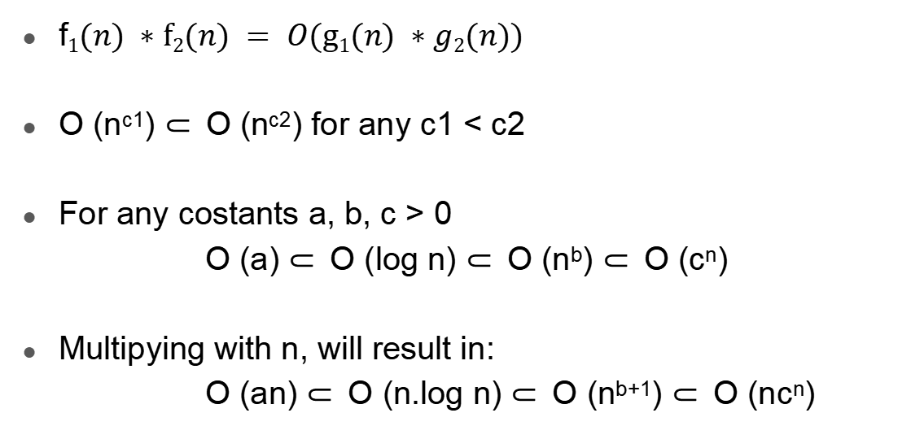
Arithmetic of of Big-O, Ω and Ө Notations
f$1(n) ∗f2(n) = O(g1(n) ∗g2(n))$
O (n^{c1}) ⸦ O (n^{c2}) for any c1 < c2
For any costants a, b, c > 0
O (a) ⸦ O (log n) ⸦ O (n^{b}) ⸦ O (c^{n})
Multipying with n, will result in:
O (an) ⸦ O (n.log n) ⸦ O (n^{b+1}) ⸦ O (nc^{n})

Slide 30
Little-o Notation
Let f(n) & g(n) be functions defined on the positive integers.
What do we mean when we say “f(n) is o(g(n))”?
f(n) becomes insignificant relative to g(n) as n approaches infinity:
limit [f(n) / g(n)] = 0
n→ ∞
g(n) is an upper bound for f(n) that is not asymptotically tight.
In Math
f(n) = o(g(n))
⇔ ∀ c > 0, ∃ n₀ > 0 s.t. ∀ n ≥ n₀ ,
f(n) < c · g(n)
Notes:
Say T(n) = O(f(n)) is loose analogy of saying “T <= f”

Slide 31
o notation
f(n) = o(g(n)) for any constant c > 0 there is a constant n₀ > 0 such that
0 ≤ f(n) < c · g(n)
3n² + 5n = O (n²) asymptotically tight.
But
3n² + 5n = O (n³) is not asymptotically tight.
3n + 5 = O (n²) is not asymptotically tight.
3n + 5 = o(n²)
3n² + 5 ≠ o(n²)

Slide 32
Little- ω Notation
Let f(n) & g(n) be functions defined on the positive integers.
What do we mean when we say “f(n) is ω(g(n))”?
f(n) becomes very large relative to g(n) as n approaches infinity:
limit [f(n) / g(n)] = ∞
n→ ∞
g(n) is an lower bound for f(n) that is not asymptotically tight.
In Math
f(n) = ω (g(n))
⇔ ∀ c > 0, ∃ n₀ > 0 s.t. ∀ n ≥ n₀ ,
f(n) > c · g(n)
Notes:
Say T(n) = O(f(n)) is loose analogy of saying “T <= f”

Slide 33
ω notation
f(n) = ω(g(n)) for any constant c > 0 there is a constant n₀ > 0 such that
0 ≤ f(n) > c · g(n)
3n² + 5 = ω(n)
3n + 5 ≠ ω(n)
g(n) is lower bound for f(n) that is not asymptotically tight.

Slide 34
Asymptotic Notation Summary
Bound | Definition (How To Prove) | It Represents
f(n) = O(g(n)) | ∃ c > 0, ∃ n₀ > 0 s.t. ∀ n ≥ n₀, f(n) ≤ c ᐧ g(n) | upper bound
f(n) = o(g(n)) | ∀ c > 0, ∃ n0 > 0 s.t. ∀ n ≥ n0 , f(n) < c · g(n) | upper bound Not asymptotically tight
f(n) = Ω(g(n)) | ∃ c > 0, ∃ n₀ > 0 s.t. ∀ n ≥ n₀, f(n) ≥ c ᐧ g(n) | lower bound
f(n) = ω(g(n)) | ∀ c > 0, ∃ n0 > 0 s.t. ∀ n ≥ n0 , f(n) > c · g(n) | lower bound Not asymptotically tight
f(n) = Ө(g(n)) | f(n) = O(g(n)) and f(n) = Ω(g(n)) | tight bound

Slide 35
Comparison Of functions
f(n) = O (g(n)) ≈ a ≤ b
f(n) = Ω(g(n)) ≈ a ≥ b
f(n) = Ө(g(n)) ≈ a = b
f(n) = o(g(n)) ≈ a < b
f(n) = ω(g(n)) ≈ a > b

